Slide 1
Solving a Diversity Problem through Course Design
Samuel Azasu
Division of Building and Real Estate Economics – KTH Stockholm

Slide 2
Problem
Growth in international education in non-traditional destinations e.g. Scandinavia
Some consequence
Diversity in student backgrounds and abilities
Presents opportunities, challenges
Solutions at the program level/individual course level

Slide 3
Case
Students from 2 different programmes learn how to value real estate in groups
Group 1
All over the world
22,5 credits prep courses
3-4-5 scale grading
Passed TOEFL
Group 2
Mostly former USSR and the Balkans
7,5 credits prep courses
P-F scale grading
No TOEFL requirement, first time studying in English

Slide 4
Challenge
Provide valuation skills at highest standard
Challenge Group 1 students,
not leave out Group 2 students (with weaker backgrounds)
Create workgroups
Team skills is a learning outcome

Slide 5
Course Design
Project work (basic theory)
Project presentation
Lectures (basic theory)
Guest lectures
Exam

Slide 6
Final Grades 3-4-5 scale (2007)
Similar to previous years
Group 1
Group 2

Slide 7
Student Evaluations - mixed reviews
The intention of the course was good, but because of some factors, like difference in background knowledge, it didn't satisfy my expectations.
It's better to change the lecturer of this course especially in this international programme.
My background was much too low. I have a completely different background knowledge, as a result this course was quite difficult to me – [to understand everything], I should at least study one year, or I should [be given] much more time than is allowed in the schedule.
After all we learnt during the MSc., I felt like I was going backwards.
I strongly recommend to divide [the groups ] into two courses

Slide 8
Student Evaluations - mixed reviews
[Group 1/Group 2] mix did not work because of gap in knowledge. Felt that [Group 1] could have learned much more.
I have been in groups at Universities with people from many countries, worked in international firms, large and small projects.....[and more of the same]....and I have NEVER met such stupid, unmotivated people before!!!
DO NOT put together the Master courses. No one made any friend with this experiment. The level they have is far too low with [Group 2], and the effort they put in is nearly 0 %. If you think you are tired of hearing this, you haven't even heard half of what happened.

Slide 9
Review based on 3 ideas
Conventional course design does not work well with diversity of student backgrounds
Constructive alignment (Biggs, 1999)
Explicit alignment between objectives, course activities and assessment
The role of assessment in supporting student learning behaviour (Gibbs & Simpson, 2004)

Slide 10
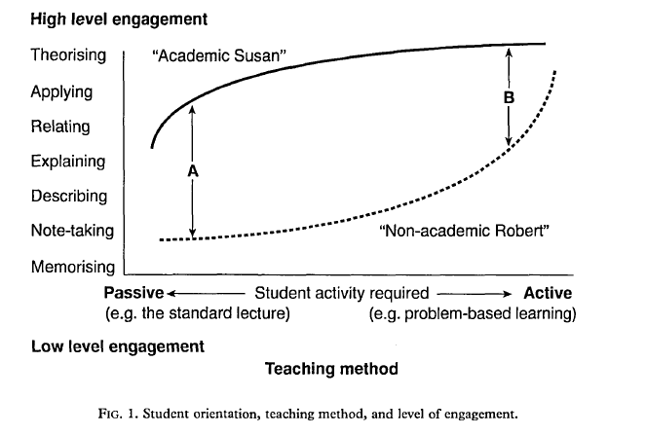
Biggs (1999), pp. 59

Slide 11
Gibbs & Simpson’s 4 assessment conditions
Increases time on task (in and out of class)
Compels student to spread effort evenly during course
Move students progressively to deeper levels of understanding
Interim assessment can also be used to equalize critical foreknowledge before higher level work commences
Communicates expectations

Slide 12
New Course Design (2008)
Mid-term exam
Project work (basic theory)
Project presentation
Lectures (basic theory)
Guest lectures
Exam
Changed grading:
Both groups graded on the A-F scale
Passed midterm and project -> grade E
Higher grades decided by final exam
Remedial teaching for LM group

Slide 13
Grades
Group 1
Group 2

Slide 14
Feedback
So far it is the best course I have attended here at KTH ...
The guest lecturers were also very interesting and their presentations complemented the lectures and the project. There, [ … ], should be a session where a summary linking the guest lectures and the course can be explored before the exam.

Slide 15
New Course Design (2009)
Mid-term exam
Lectures (basic theory)
Project work (basic theory)
Project presentation
Homework
Guest lectures
Exam
Changed grading:
Homework, midterm and project -> grade E
Higher grades decided by final exam
Again, remedial teaching for Group 2

Slide 16
 | Distribution based on grades
 | Group 1 |  | Group 2 |  | Exchange students |  | Total
Grade | No. | Share (%) | No. | Share (%) | No. | Share (%) | No. | Share (%)
A | 2 | 8 | 9 | 18 | 2 | 20 | 13 | 16
B | 12 | 48 | 14 | 29 | 2 | 20 | 28 | 33
C | 9 | 36 | 12 | 25 | 3 | 30 | 24 | 29
D | 1 | 4 | 3 | 6 | 3 | 30 | 7 | 8
E |  |  | 11 | 22 |  |  | 11 | 13
F | 1 | 4 |  |  |  |  | 1 | 1
FX
Total | 25 | 100 | 49 | 100 | 10 | 100 | 84 | 100

Slide 17
Feedback
“…the idea of the midterm exam was genius; it helped us to learn the concepts necessary for the project.”
“The project was really engaging and it tested our team working skills a lot. However, at the end of it, I learnt a lot from my colleagues and it helped me to appreciate the theory better.”
“Coursework arrangement was super!! It put us [under] a lot of pressure but the fruits were sweet!!”
“I really enjoyed the Project working with 4 different guys from different countries and perhaps background. We started as enemies ended up as lovely big friends!”
“Sometimes the things taught are not given sufficient time for students to master. It is important to have sufficient time for students to understand what is taught before moving forward. The teachers should look at the weak students as a reference rather than the best students before concluding things are clear to the students and moving on.”

Slide 18
Feedback
“Really appreciated most of the "design" of the course with mid-term for instance. However, at times you could feel quite overwhelmed by all the exercises, assignments etc.”
“The first part of the course felt very structured and motivating while the second felt too loose and uninspired”.
“Guest lectures lecturing about forest and the taxation system was extremely bad in speaking English. It was impossible to understand and learn anything from them”.

Slide 19
Key Lessons
What do all these mean for the future?

Slide 20
What Went Right
Assessment is key
Even small changes can have big effects
Greater time on task, deep rather than surface approaches to learning
Changes in grading of project
Focus on process instead of outcome
Improved course design benefits even the “good” students
Industry feedback on report quality was strongly positive

Slide 21
What Went Wrong
Poor course design induces students to adopt surface approaches to learning
Group conflict between surface and deep learners unavoidable, resentment toward teachers likely
Consensus within department – split them up
Costly for the division
Lack of know-how on diversity management
Deprives cross-cultural learning experiences

Slide 22
Reflections
Assessment type and timing can result in fundamental changes in student behaviour
Some “blame the student” and “blame the teacher” talk is actually about bad course design
Ability to correctly interpret student feedback is critical
It takes pedagogic know-how to trouble-shoot courses and design appropriate interventions
Teachers and departments must have pedagogic leadership

Slide 23
Illustration
Consider the following feedback from a student:
“Assistants should know the task and state clearly requirements and not confuse students.”
Possible interpretations
Ill-prepared teaching assistants
Low student tolerance for ambiguity
Students unable to handle uncertain situations

Slide 24
Questions & Comments

