Slide 1
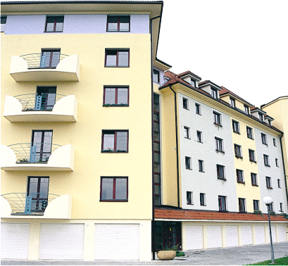
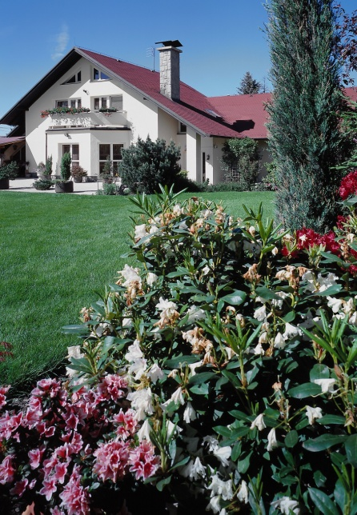
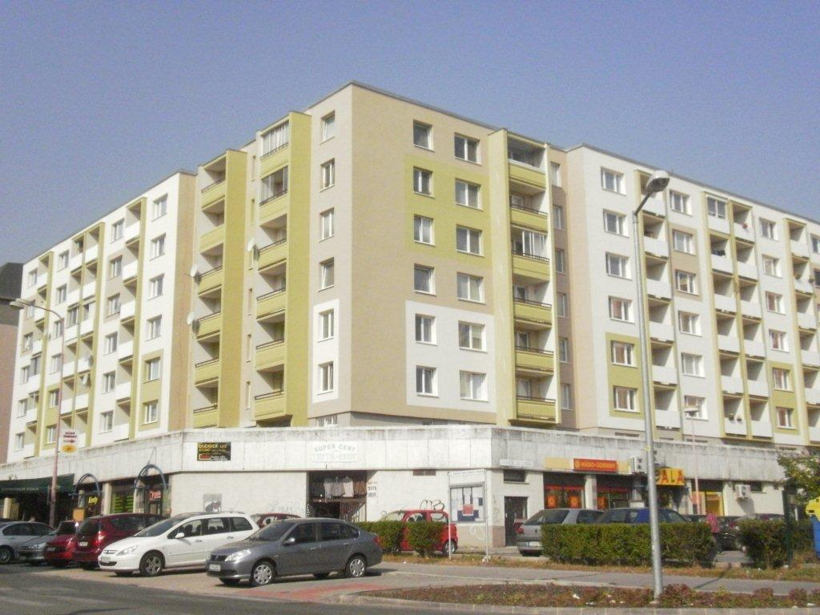

Dwelling houses -
Facility management and finance management for renovation
Ing. Miloš Blanárik
Communication director
6th december 2013

Slide 2
HISTORY
  Between 1948 and 1990 owning property in Slovakia was almost impossible
  All land and real estate was government-owned and only rented to anyone building a house
  Large number of residential units constructed (up to 45,000 per year)
    Regulated materials
    Factory-produced - poor quality construction
    Virtually no maintenance and never renovated
  1990 - private property returned - population hungry for real estate
  1993 - Act 182/1993 on Apartment Ownership - 97% of residential housing privatized by 2005.

Slide 3
CONSEQUENCES OF PRIVATIZATION
    Property prices rose 100-fold between 1992 and 1993 - became unaffordable
    Only workable mechanism for financing the purchase of a home - building societies - were established just in 1992 and the first loan was taken out in 1994
    Purchases were primarily financed by savings from the previous era until 1996
    End of qualified institutional investors - rise of developer market
    Lack of labor mobility due to housing shortages

Slide 4
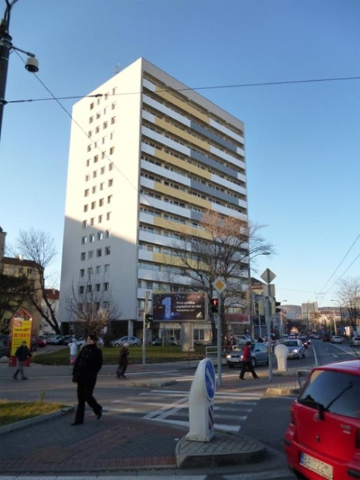
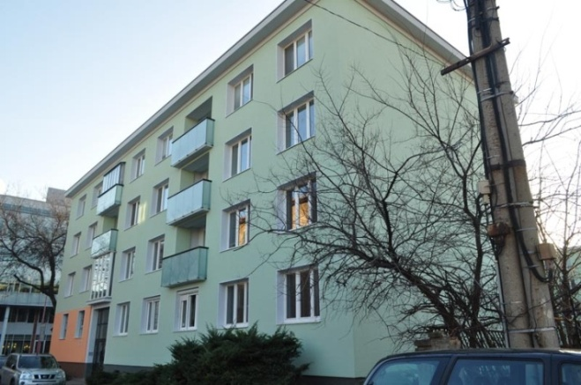
EXISTING HOUSING – FACTS AND DEVELOPMENT
Residential housing in Slovakia
comprises almost 900,000 dwellings.
3/4 of them were constructed with panel-house technology and mass-produced using standardized solutions - this ended in 1993.
Up to 80% of them were built before 1993 and most of them currently require renovation.

Slide 5

CONSEQUENCES OF PRIVATIZATION – INFORMATION VACUUM FOR NEW OWNES ABOUT ITS PROPERTY
    Housing transferred from national to local governments
    Residential units sold to the local population for a symbolic price of €1,000 - only 3% of them remained municipally owned
    Neglected residential blocks and units require immediate emergency solutions - roofs, boilers, elevators
    No system existed before 2000 for financing major investments in major multiple-dwellings - only for individual units and single-family houses
    In 2000, legislation allowed building societies to finance renovations, subsequently taken over by SHDF (State Housing Development Fund) and commercial banks

Slide 6
OWNER EXPECTATIONS...
    Dwelling houses renovations funded by the government – not real
    Assistance can be obtained for renovations to a limited degree for system breakdowns - and only a small amount per year - delayed renovation
    People get resigned - let someone else take care of it
...AND FACT
    PSS, a.s., has developed a system for financing renovations including securing a loan.

Slide 7

CURRENTLY – MAIN ECONOMIC INSTRUMENTS FOR FINANCING MUTTIPLE-UNIT RENOVATIONS
ASSISTANCE to eliminate system breakdowns (up to a maximum 50% of eligible costs) and for solar collectors
GOVERNMENT LOANS - from SHDF
BUILDING SOCIETY LOANS - with government bonuses for owner associations
COMMERCIAL BANK LOANS
GOVERNMENT BANK GUARANTEES
OWN RESOURCES (savings for residential block repairs...)

Slide 8
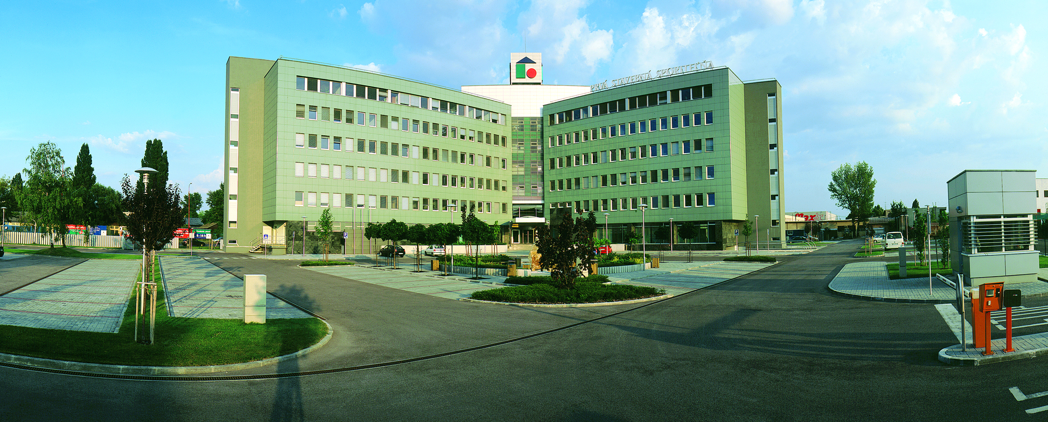
PRVÁ STAVEBNÁ SPORITEĽŇA, A. S.
...is a bank that specializes in housing.
It has operated in Slovakia since 1992.
PSS, a. s., offers:
preferred savings with government bonuses
and affordable housing loans
not only for individuals but since 2000 for legal entities, too.
BUILDING SAVINGS:
Closed system
Independent of crisis-related changes in the financial market
Stable conditions

Slide 9
BULDING SAVINGS FOR LEGAL ENTITIES
Designed primarily for owners of residential block suites and offices to manage:
Residential and non-residential owner associations
Housing cooperatives
Other superintendents managing multiple-unit dwellings
GOVERNMENT BONUSES FOR OWNER ASSOCIATIONS:
Government bonuses for owner associations in 2013 - maximum €66.39 per every 4 units
Annual contribution of €577.30 for a government bonus

Slide 10
RESOURCES FOR HOUSING

Slide 11
SHARE OF PSS, a. s.

Slide 12
TOTAL RESOURCES FOR HOUSING (PSS, a. s.)
mil. €
Total volume
2013
420,07 mil. €
Total volume
21 years
7,64 mld. €
buying
new
home building
reconstruction
another purposes

Slide 13
HOW A BULDING SAVINGS AND LOAN CAN BE USED
Building savings can finance total renovation, modernization, construction work, repairs at multiple-dwelling common areas and facilities, also alternative energy sources and residential-block energy certification
GENERAL CONDITIONS
2/3 of owners have their loans and security for the loan approved
Targeted use of funds in accordance with the Building Societies Act
Sufficient creditworthiness (creating a fund for operations, maintenance and repair
Securing a loan

Slide 14
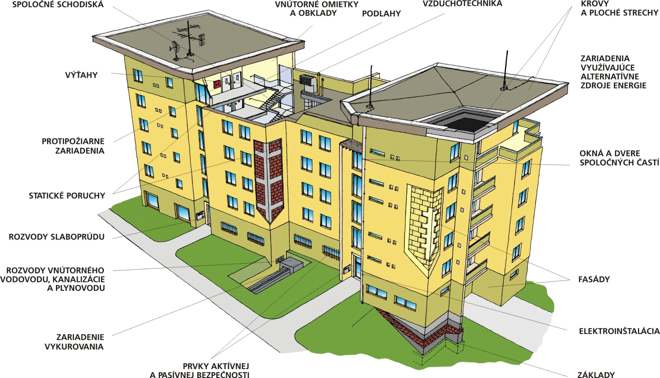
HOW A BULDING SAVINGS AND LOAN CAN BE USED
Staircases
Wall facing
Ventilation
Roofs
Floors
Alternately resources of energy
Lifts
Back-fire machines
Windows
and doors
Statics
Energy distribution
Water and gas distribution
Foreside
Electroinstallation
Heating apparatuses
Window
grillage
Basises

Slide 15
CREATING AN EDUCATION SYSTEM PSS, a. s.
    Partners in education
      Target groups - superintendents, housing cooperatives, community owner associations, owners, municipalities, developers
      Instructors - Slovak University of Technology, TSUS, VVUPS, University of Economics, government representatives - Ministry of Finance, Ministry of Transport, Construction and Regional Development
      Higher institutional learning at universities are replaced by accredited agency courses - 3 in Slovakia
    Licensing superintendents:
    Anyone can currently be a superintendent with no proper training
    Develop specific legislation governing superintendents

Slide 16

CONSEQUENCES OF UNQUALIFIED SUPERINTENDENTS
    High energy consumption at blocks
    Preference for cheap and ineffective solutions
    High equipment failure rate and high maintenance costs
    Persistence faults due to complexity of owner decision-making
    Lack of qualified contractors

Slide 17
REGULATION AND INCENTIVES TO RESTORE AND UPGRADE PROPERTIES
    Energy certificates underlying transfer of properties
    Regulatory conditions for loans involving EU ans SHDF funds -minimum 40% savings energy
    Motivational conditions for loans from PSS, a.s. - complexity and higher loans at lower interest rates
    Repaying loans from money saved in using less energy
    Real estate market frozen since 2009

Slide 18
MOTIVATION
    Compete for the best restored multiple-dwelling
    Awards for exemplary restorations of houses
    Television shows - Energetika Slovenska (Energy Slovakia), Bezpečné bývanie (Affordable Living), Prrerábame, sporíme, staviame (Design, Save, Build), Obnovme si domov (Restore Your Home)
    Discounts on materials and labor from around 700 PSS, a.s. partners
    Free home assessments - only for saving energy

Slide 19
WHAT TO FOCUS ON...
1.
    Houses need to be renovated about every 20 years
2.
    Regular restoration and maintenance (every 5-10 years) is significantly cheaper
3.
    Savings can be immediately seen at each step as the house’s operating efficiency continues growing
4.
    Property never loses either its technical parameters or its worth
5.
    There is permanent pressure on owners of public institutions due to improvements and maintenance of public spaces

Slide 20
QUALIFIED PROPERTY MAINTENANCE
    Requires qualified service staff - superintendents and contractors
    Requires motivated owners with skills
    Requires high-quality property maintenance legislation
    Requires a system of institutional education of superintendents and owners
    Requires transparent access to information on property maintenance and technical equipment

Slide 21
THANK YOU
FOR YOUR ATTENTION
Ing. Miloš Blanárik
Prvá stavebná sporiteľňa, a. s.
Bajkalská 30
829 48 Bratislava
e-mail: mblanarik@pss.sk

