Slide 1
Multi Disciplinary, Cross Listed Experiment in Course Delivery and Deliverables, with Professional Assistance
Susanne Ethridge Cannon
Chairman, Department of Real Estate and
Douglas and Cynthia Crocker Endowed Director
The Real Estate Center
DePaul University

Slide 2
Multifamily Housing Policy and Finance
Four faculty members (3 of them adjunct)
Eight young professional architects
College of Business and School of Public Policy students
Three major speakers
  Valerie Kretchmer
  Linda Thurman
  John Norquist
One expert panel discussion

Slide 3
Student Activities and Deliverables
10 weekly classes
One field trip
Market Analysis
Financial Feasibility (team)
Roseland Senior Housing Case Write Up
Exam
Final presentation and paper (team)

Slide 4
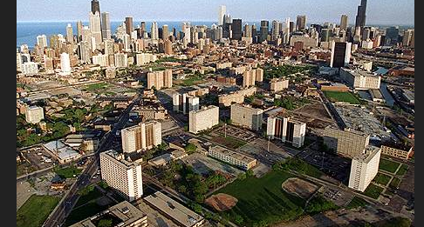
Cabrini Green

Slide 5
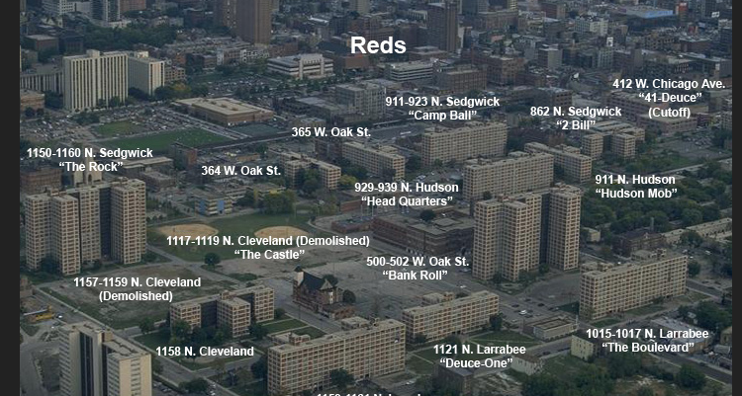
Life Inside the Green

Slide 6
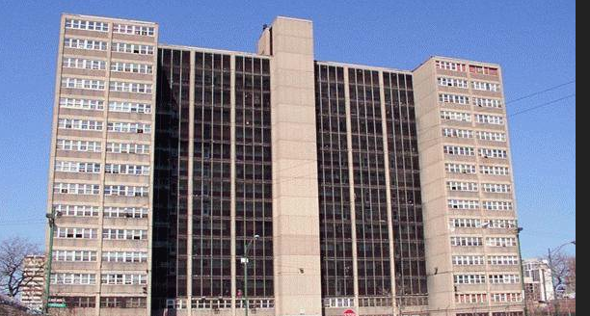
The Whites

Slide 7
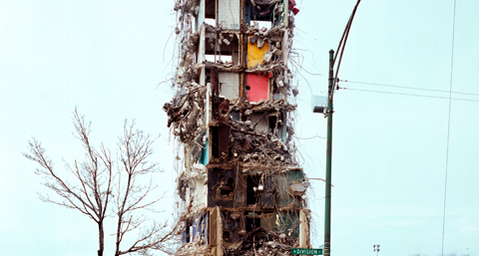
The Last Building

Slide 8
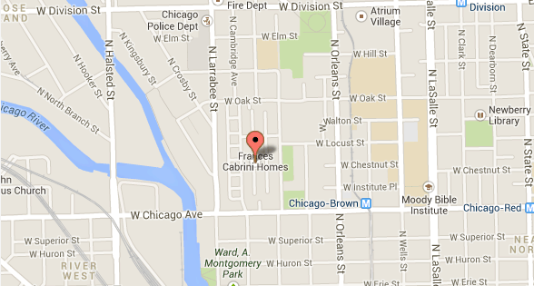
Frances Cabrini Homes

Slide 9
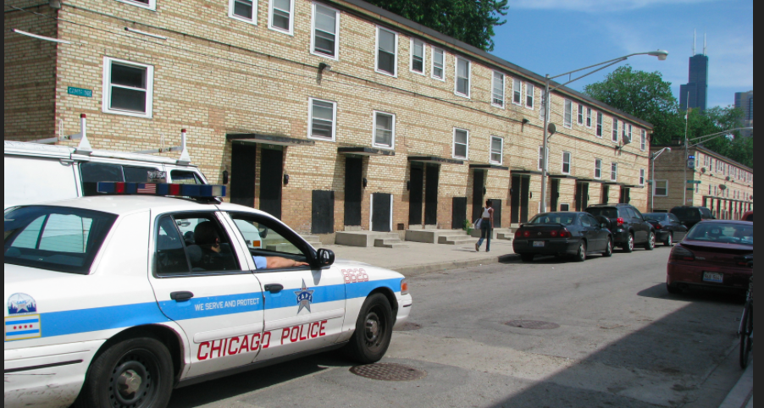
Row Homes

Slide 10
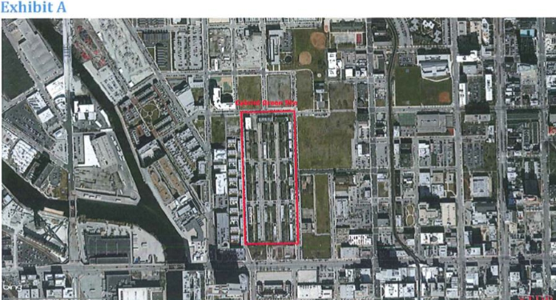
Development Site

Slide 11
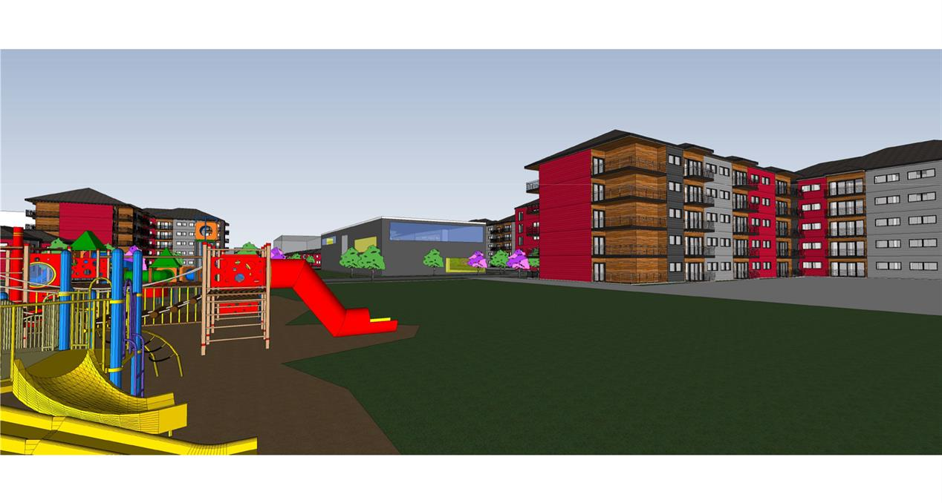
Student Proposal

Slide 12
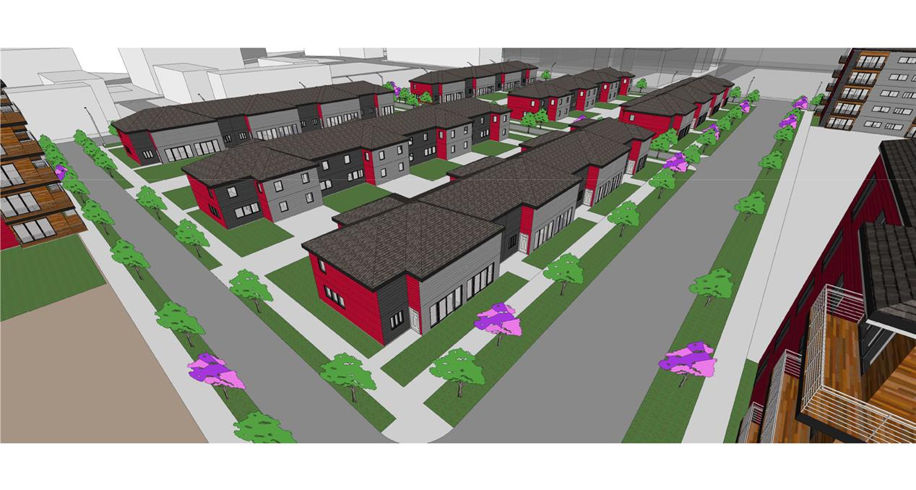
Student Proposal

Slide 13
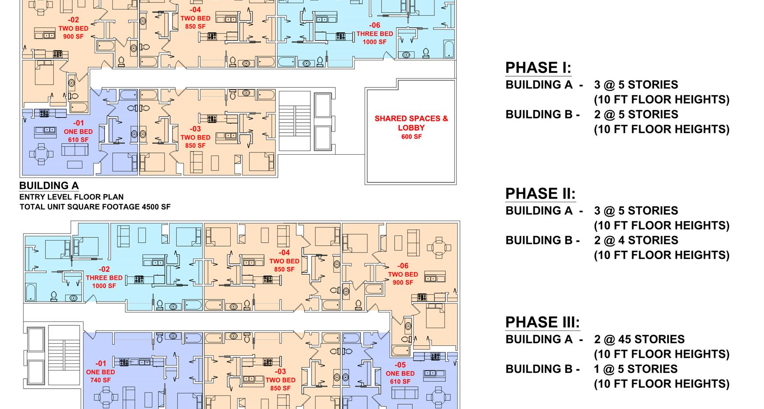
Sample Floor Plans

Slide 14
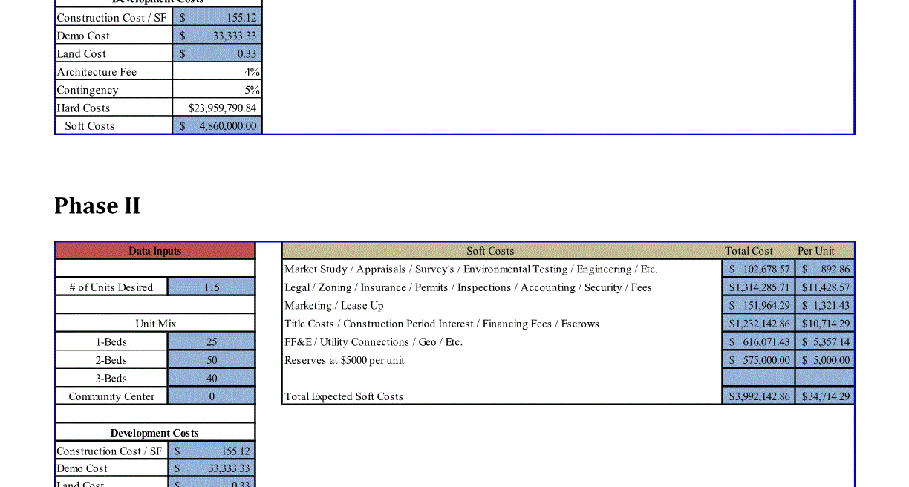
Phase 1 and 2

Slide 15
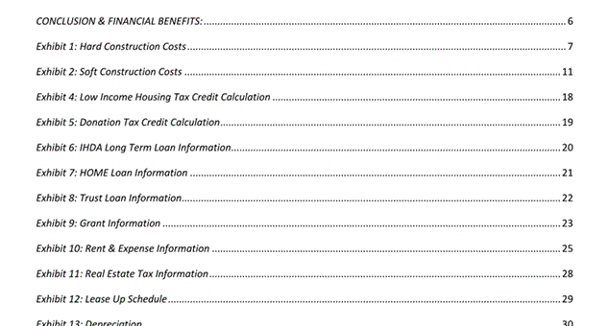
Final Project Appendix

Slide 16
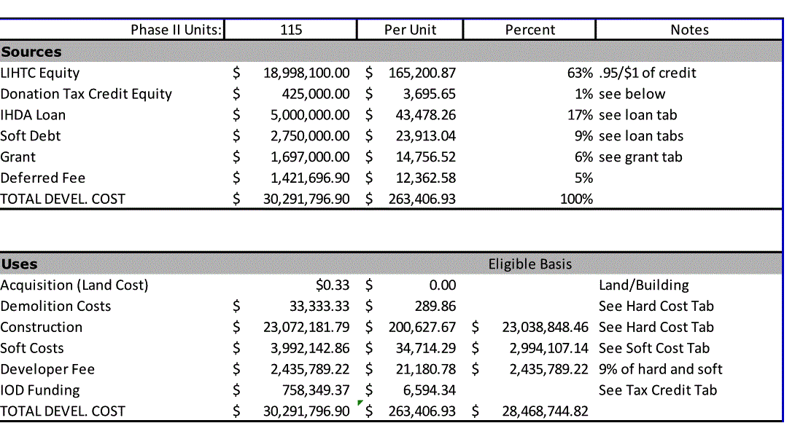
Sources and Uses

Slide 17
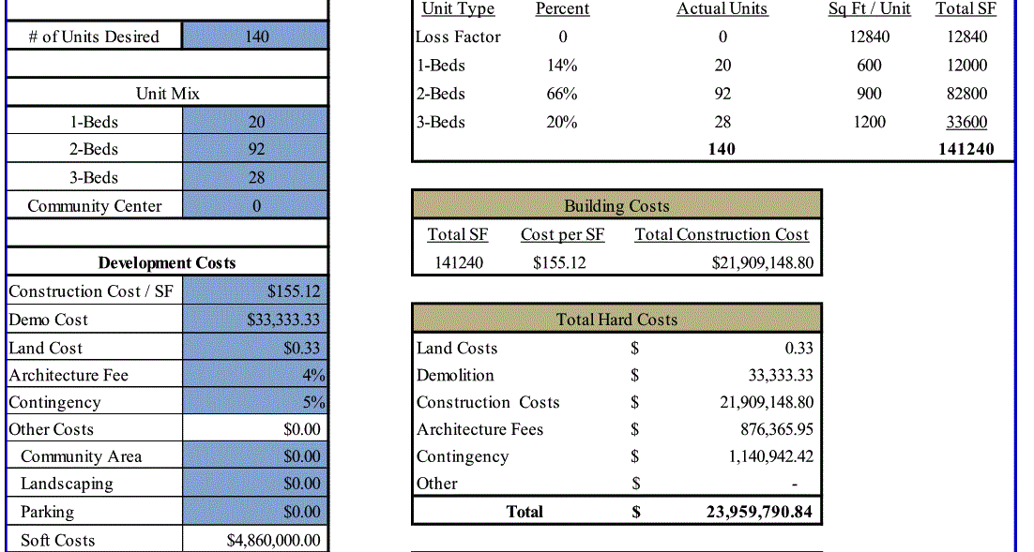

Slide 18
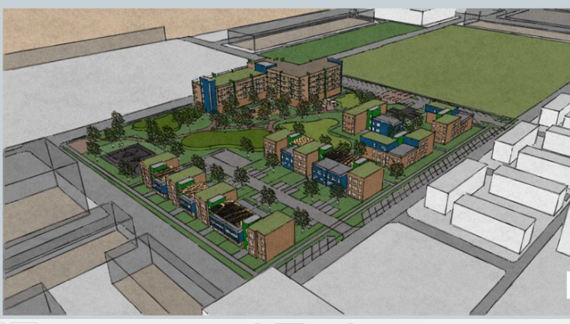
Proposal 2

Slide 19
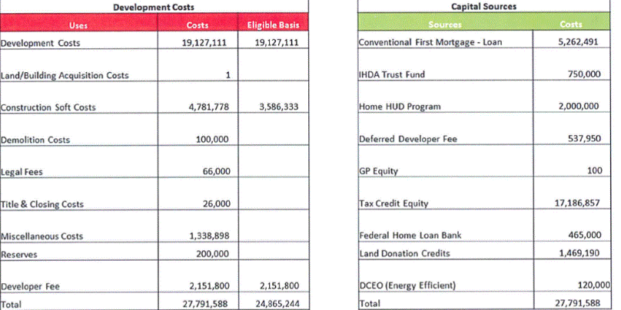

Slide 20
Concuding the Experiment
Remarkable community engagement
Dedicated team of architects
Student issues, specifically SPS
Work Product

